Slide 1
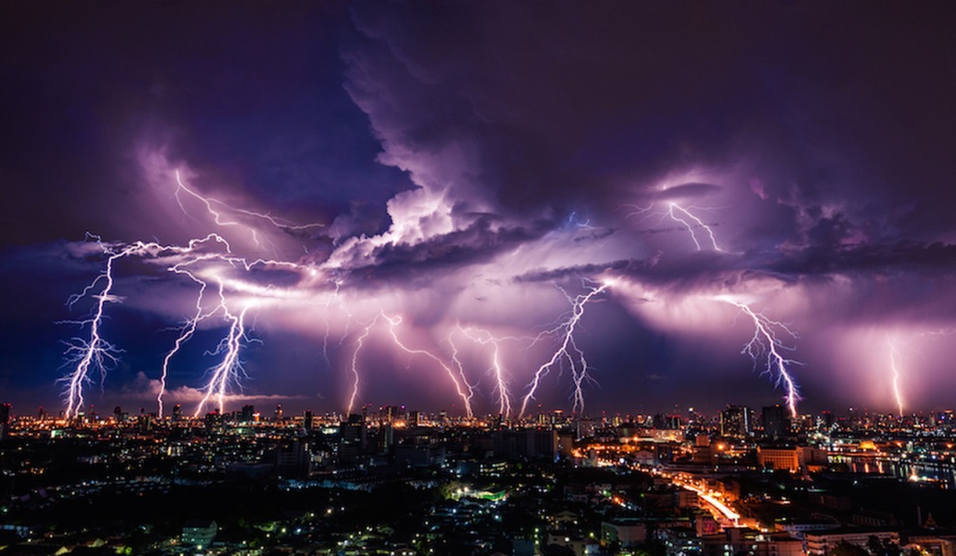
ENERGY and CHANGE
1. STATIC ELECTRICITY
2. CURRENT ELECTRICITY
3. LIGHT

Slide 2
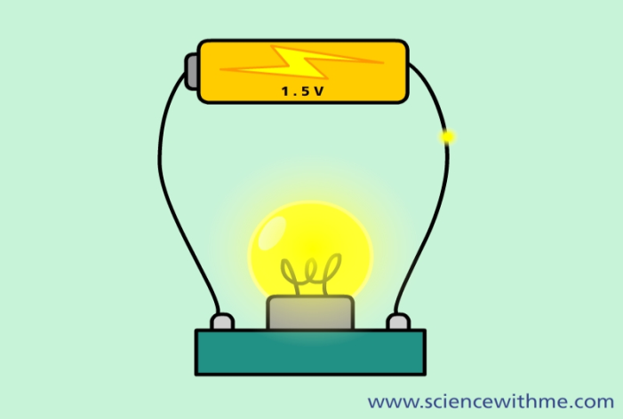
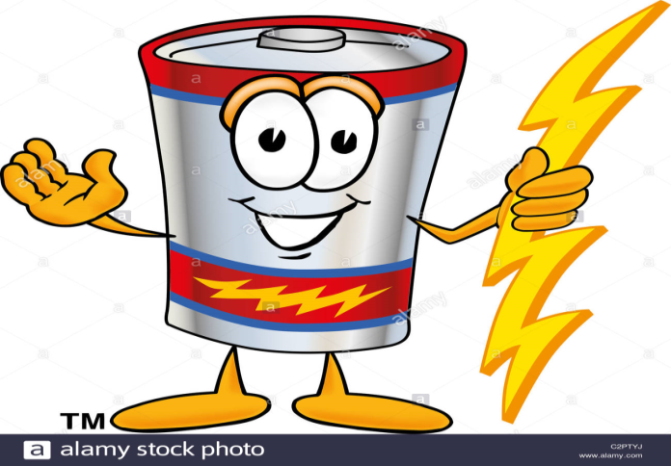
ELECTRICITY
Positive protons stay in the nucleus – they cannot move.
Negative electrons are already moving around the nucleus. So they can also be made to move away from it.
So the word ELECTRICITY could come from the words ELECTRON-CITY, because it results from the movement of negative charges.
Conductor: something through which electrons can move.
Insulator: something that electrons cannot move in.

Slide 3
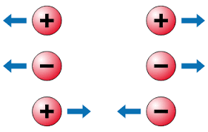
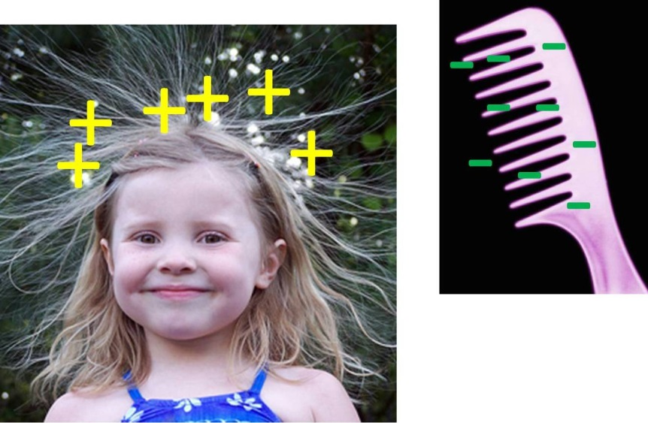
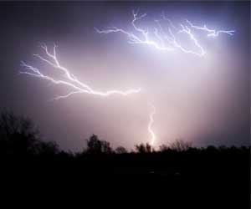
PART 1: STATIC ELECRICITY

Slide 4
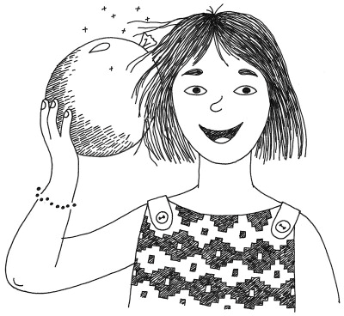
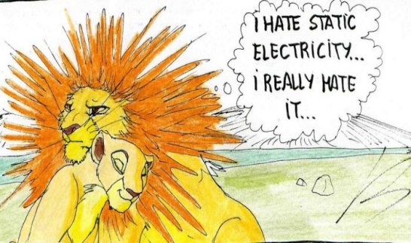
STATIC ELECTRICITY
When two insulators are rubbed together, some electrons are rubbed from one of them onto the other.
The one losing electrons becomes positively charged.
The one gaining electrons becomes negatively charged.
Being insulators, these charges cannot go anywhere, and so this electricity is called static. (= Not moving.)
If charged insulators are brought close to each other:
Opposites attract. Like charges repel.
If they are brought close enough, electrons can jump (as a spark) from the negative one to the positive one.
This is how charged clouds can cause lightning.

Slide 5
QUESTIONS: Pages 87-88
Question 1
1. B 2. C 3. D 4. A 5. A
6. A 7. C 7 X [2] = [14]
Question 2
1. Static 2. more 3. fewer 4. attract; repel
5. Friction [6]
Question 3
First is: NEGATIVE. Second is: NEUTRAL. [2]
If the air is humid, water collects on the surface, and so electrical charges cannot build up. [3]
Electrons from negatively charged object jump onto positive object, and release energy to form a spark. [4]

